Slide 1


Advance Database Topics Project
Group – 12
Pujan Soni (105167055)
Sharvil Patel (110021109)
Jay Patel (110009714)
Kevin Shah (110023647)
Query Searching with Similarity Measures
Guided By : Dr. Kalyani Selvarajah
1

Slide 2

Overview
Introduction
Existing Work
Step-by-step Process
Jaccard Similarity
Cosine Similarity
Tools and Technology
Demo
Questions
2

Slide 3

Introduction
Similarity Measure - Similarity is the measure of how often two data items are similar. Similarity in a context of data mining is usually described as a distance, with dimensions representing object characteristics (documents, images). If this distance is small, then there will be a high degree of similarity; if a distance is large, the similarity will be low. Similarity is measured in the range 0 to 1 [0,1].
While working on natural language processing models for search engines, text similarity metrics such as Jaccard, cosine, Euclid distances are used for better query search optimisations and processing time.
In text analysis, the similarity of two texts can be evaluated in its most basic form by describing each text as a set of word counts and by measuring distance using those words as features
3

Slide 4
Introduction
We have worked on the COVID-19 database for improving dynamic query suggestions and comparison between MySql Pattern Matching, Jaccard Similarity and Cosine Similarity.
If the system search for the article or keywords containing more than two words, In MySql, result will be separated. While in Similarity metrices, result will be according to the search.
The proximity of suggestions based on searched keywords will be better for Similarity metrices.
We have implemented this project to understand working with MySql, similarity metrices concept with basic natural language processing tools.
4

Slide 5
Existing Work
There are many theoretical researches done related to the implementation of the similarity measures.
A research shows that “ Autocomplete suggestions implemented in a search engine Google and a web browser which allows both to display suggestions when user type some words in the search bar or address bar implemented through the similarity distances”.
A research “ An efficient recommendation generation using relevant Jaccard similarity ” to perform better recommendation to reduce the search cost of the user using Jaccard Similarity.

Slide 6
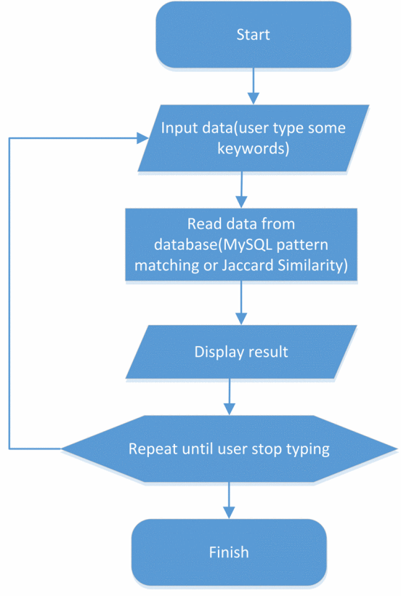
How Similarity Measure Works!!
System Flow Diagram

Slide 7
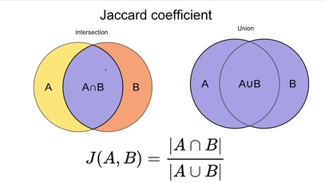
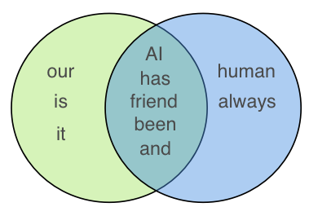

Jaccard Similarity
It is also known as Jaccard coefficient or Jaccard Index
It uses Lemmatization , result will be in [0,1].
Two sets that share all members, value will be 1.
If they share no members, it will be 0.
For example, Sentence 1: AI is our friend and it has been friendly Sentence 2: AI and humans have always been friendly
Value is $\frac{5}{5+3+2}= 0.5$
It is better for text similarity where duplication doesn’t matter

Slide 8
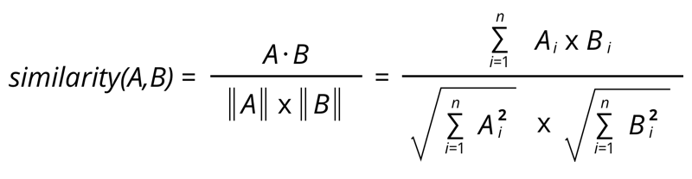
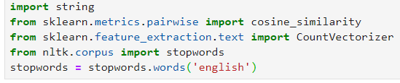
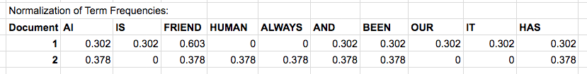
Cosine Similarity
It calculates the cosine of angle between two vectors( i.e. Sentence 1 & 2)
Converts Sentences → Vectors Using Bag of Words – Term Frequency or Word2Vec using CountVectorizer
Cosine is useful with large text dataset with different length of words.

Slide 9
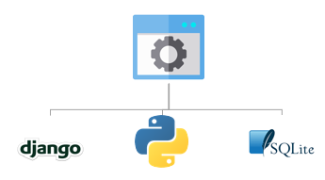
Tools & Technology
Python provides libraries such as NumPy, Pandas, SciPy, Scikit-learn, CountVectorizer to implement the frequency count of the total words,, vectorization,etc
SQLite3 to store and manage the database system
Django to develop/manage the model, load data, and develop Django command to run similarity scripts
9

Slide 10

Demo

Slide 11
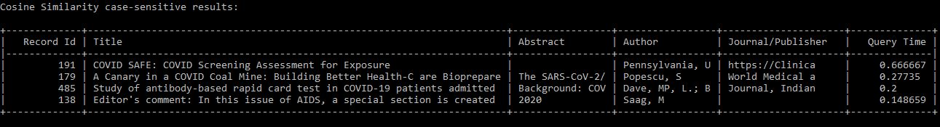
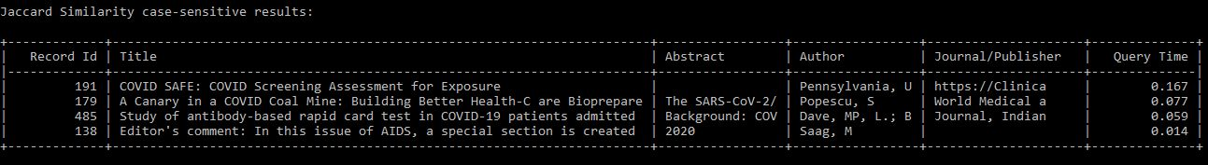
Case- Sensitivie Results of “COVID”
11

Slide 12
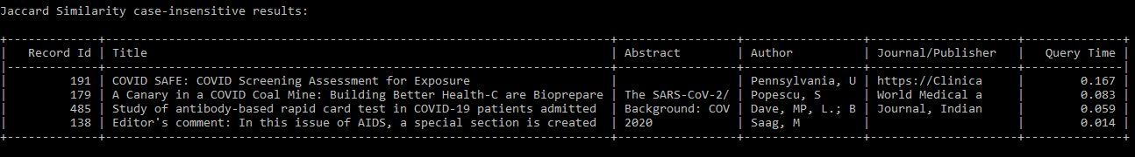
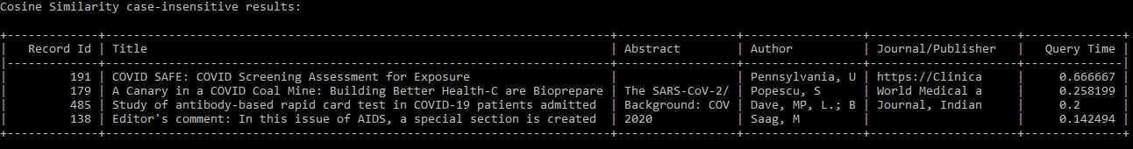
Case- Insensitivie Results
12

Slide 13
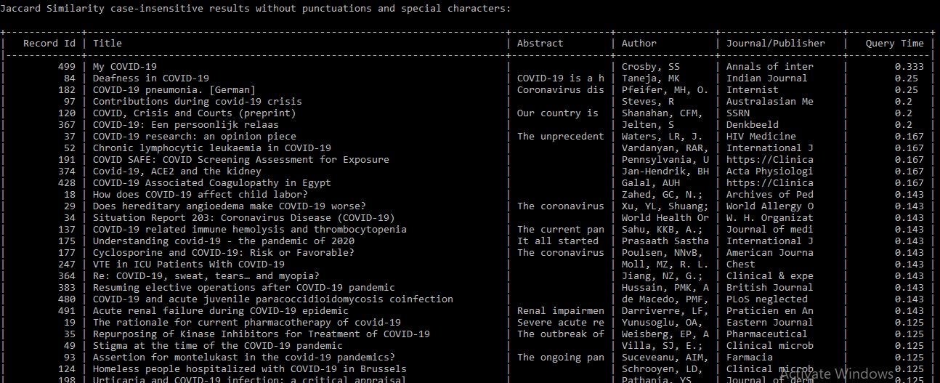
Jaccard Similarity Case- Insensitivie Result without special characters
13

Slide 14
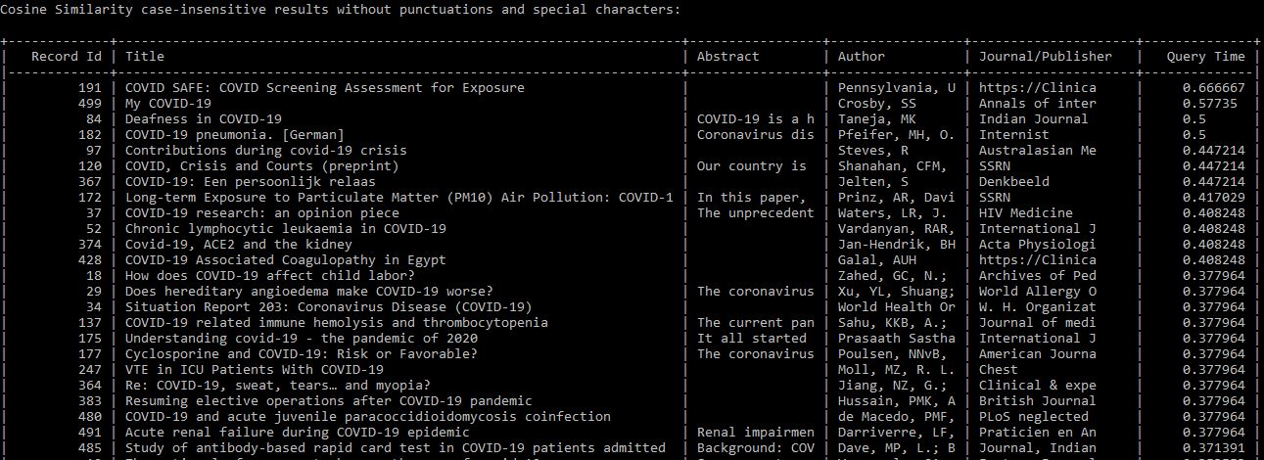
Cosine Similarity Case- Insensitivie Result without special characters
14

Slide 15

Any Questions

Slide 16


